Slide 1
MAC Address-Based Network Access Control: Security Benefits and Limitations
Aaditya Vishwakarma
16
October
2026

Slide 2
Introduction
What is MAC Address-Based Access Control?
MAC = Media Access Control
A MAC address identifies a network interface at the link layer.
Network devices can use MAC addresses to control connectivity.
Administrators can create allowlists or blocklists.
Commonly available in routers, wireless access points, and managed switches.
Provides an additional access-control layer.
Key Idea
Known Device → Allow
Unknown/Blocked Device → Deny
Confidential

Slide 3
Problem Statement
Problem
Unauthorized devices connecting to a network can create security risks.
Traditional access controls may not provide sufficient device-level visibility or restriction in every environment.
Research Question
How effective is MAC address-based network access control, and what are its security benefits and limitations?
Main Challenge
MAC filtering vs. MAC spoofing
Confidential

Slide 4
Objectives
Research Objectives
Understand MAC-based access control.
Study MAC allowlisting and blocklisting.
Analyse its security benefits.
Examine MAC spoofing as a limitation.
Study practical implementation.
Compare MAC filtering with stronger authentication.
Identify appropriate use cases.
Recommend layered security practices.
Confidential

Slide 5
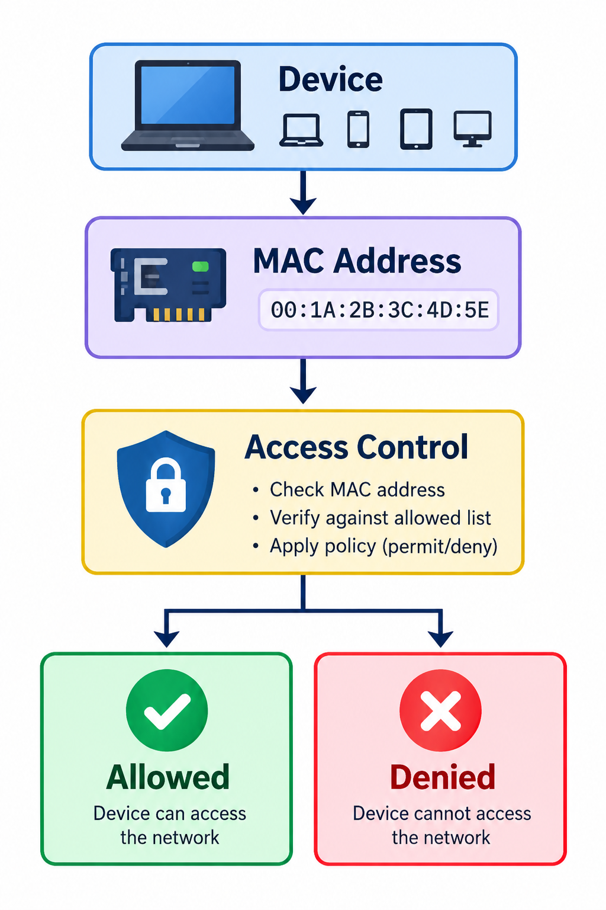
Existing Techniques
Existing MAC-Based Techniques
1. MAC Allowlisting
Only registered devices are permitted.
2. MAC Blocklisting
Specified devices are denied.
3. Wireless MAC Filtering
Access points check connecting device addresses.
4. Switch Port Security
Switch ports can restrict unexpected MAC addresses.
5. Device Monitoring
MAC addresses can assist with identifying devices on a local network.
Confidential

Slide 6
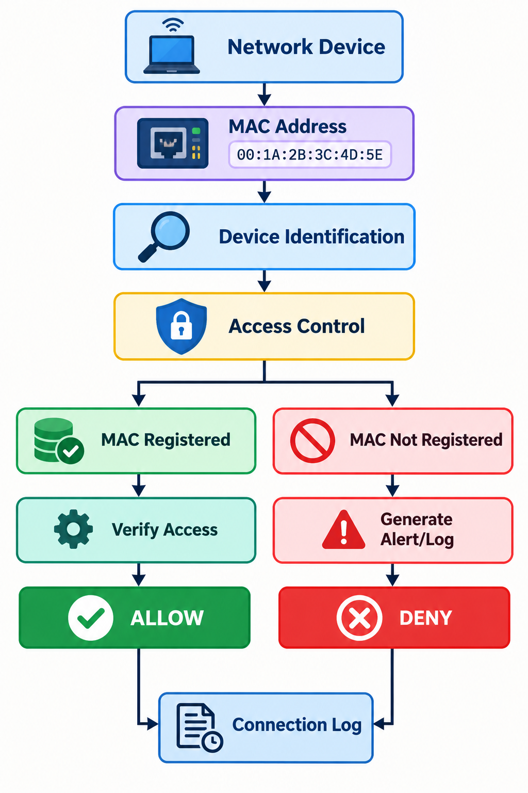
Proposed / Analysed Approach
Proposed Security Enhancement
MAC Address Verification
Device Allowlist
Access Logs
Unauthorized Device Alerts
MAC Spoofing Detection
Time-based / Port-based Restrictions
Analysis Areas
Authorized devices
Unauthorized devices
Allowlisting
Blocklisting
MAC spoofing concept
Connection logging
Security effectiveness
Comparison with stronger controls
Confidential

Slide 7
Tools & Technologies
Tools
Linux
Wireshark
tcpdump
Nmap
ip / ip link
NetworkManager
Router / Wireless Access Point
Managed Switch
VirtualBox
Technologies
Ethernet
Wi-Fi
MAC addressing
Network access control
Port security
802.1X
RADIUS
WPA2/WPA3
Confidential

Slide 8
Security Benefits
Benefits of MAC-Based Access Control
🔐 Access Restriction
Controls which device addresses are permitted.
🖥️ Device-Level Control
Helps administrators manage known devices.
⚙️ Easy Configuration
Available on many consumer and enterprise network devices.
🛡️ Additional Security Layer
Can complement other security mechanisms.
📊 Device Visibility
MAC addresses can assist with local network device identification.
Important
MAC filtering should be treated as an additional control, not a standalone security mechanism.
Confidential

Slide 9
Security Limitations
Major Limitations
⚠️ MAC Spoofing
An attacker may potentially imitate another MAC address.
⚠️ No User Authentication
A MAC address identifies an interface, not necessarily the person using it.
⚠️ Management Overhead
Large networks can have many devices and addresses to maintain.
⚠️ MAC Randomization
Modern devices may use changing MAC addresses for privacy.
⚠️ Limited Protection
MAC filtering does not by itself provide encryption or comprehensive network security.
Key Point
MAC Address ≠ Strong Identity
Confidential

Slide 10
Conclusion
Conclusion
MAC-based access control provides a simple way to restrict network connectivity.
It can be useful for controlling known devices.
It provides an additional layer of network security.
MAC addresses should not be treated as secret credentials.
MAC spoofing and MAC randomization reduce the reliability of MAC filtering as a standalone control.
Stronger mechanisms such as 802.1X, RADIUS, WPA2/WPA3-Enterprise, certificates, NAC, and network segmentation can provide additional protection.
Confidential

Slide 11
Thank you!
Contact
Aadityav1@duck.com
Confidential

